Slide 1
Individual Stroke Probability
Machine Learning Model Presentation
Solution by: Scotty Thomason

Slide 2
Business Problem:
Predictions of an individual's probability or risk of stroke :
In a situation were we can potentially determine if a patient is at risk of stroke simply by recording a few characteristics of their overall general health and specific habits. Medical institutions could pro-actively help prevent strokes by providing medications or daily routines and better understand why they occur in different instances.

Slide 3
Data:
(https://www.kaggle.com/datasets/fedesoriano/stroke-prediction-dataset)
Methods
Cleaning of the original data
Applying different models on training data
Evaluating scores
Final model creation and score

Slide 4
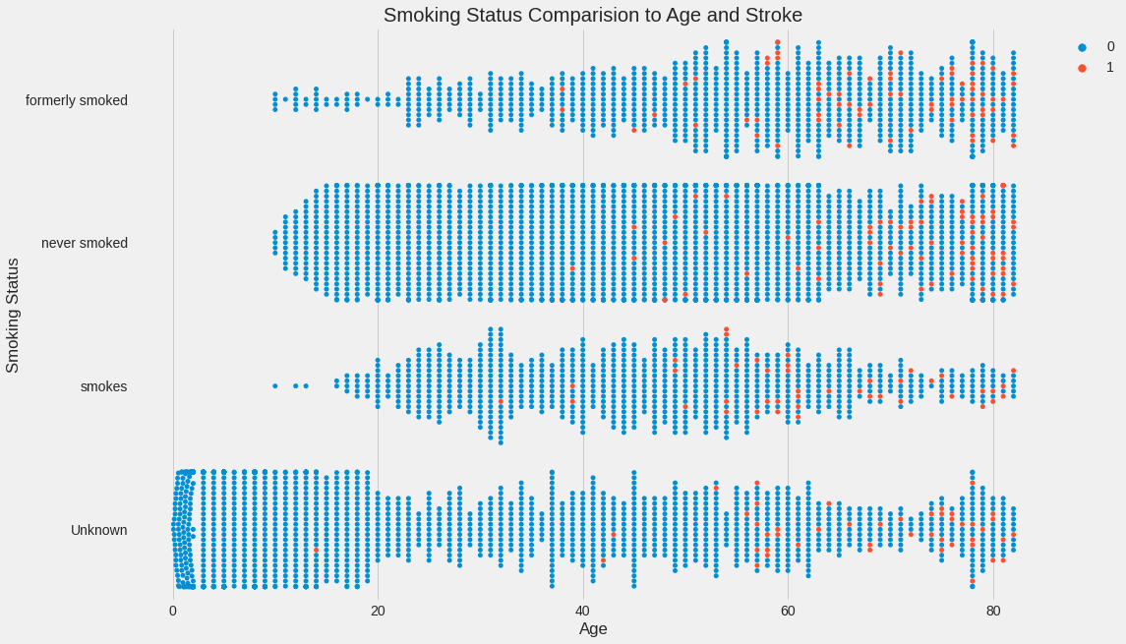
Key Findings

Slide 5
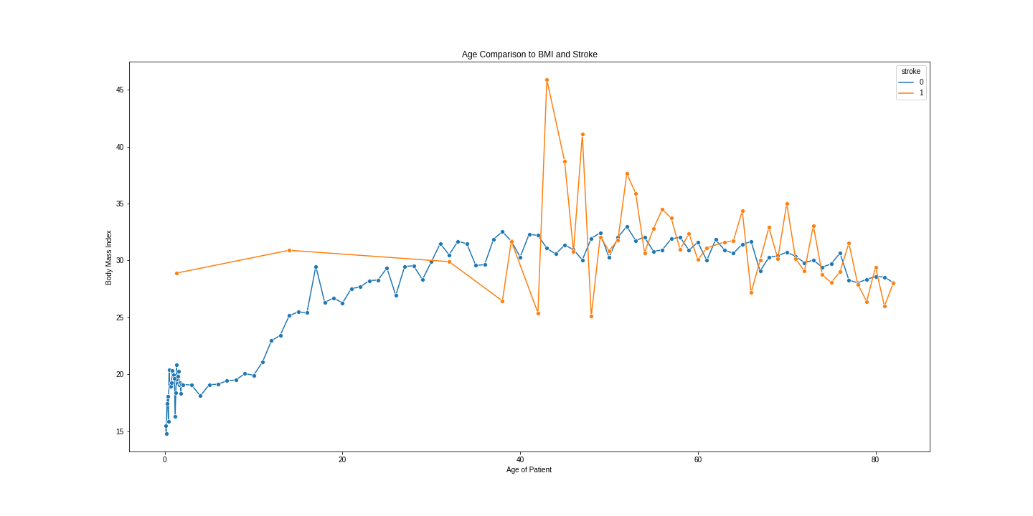
Key Findings Cont.

Slide 6
Results:
Even though the data set did not have a very high-dimension, the best model produced had an overall score of 84%. There are better models to handle these predictions and this will be updated in the future as we move forward.
Recommendations:
More trials with other models and possibly more data and categories to make a richer data set.

